Slide 1
Requirements Specifications

Slide 2
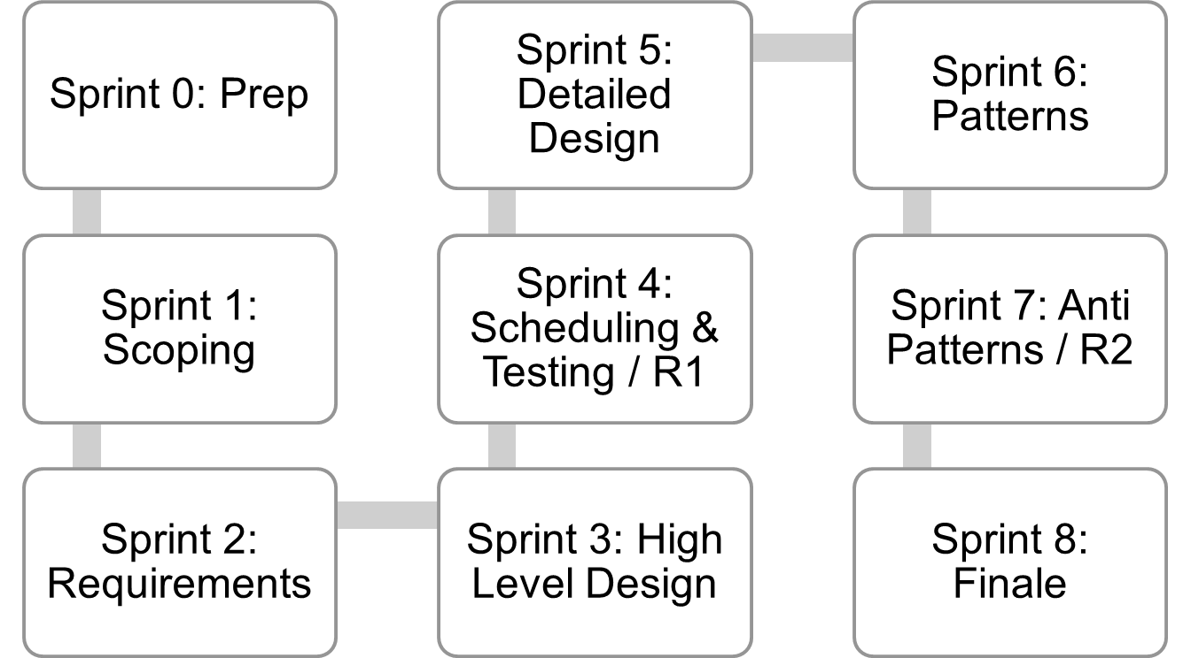
Where are we..
Jan 4
Mar 12
Mar 26
Lecture topics will follow this flow
As the projects tracks these sprints
Submissions due along the way
Guest lectures from startups and Industry leaders
EACH SPRINT IS 2 WEEKS, Friday start.
Jan 15
Feb 26
Apr 9
Jan 29
Feb 12
April 23
April 23+ EVALUATIONS

Slide 3
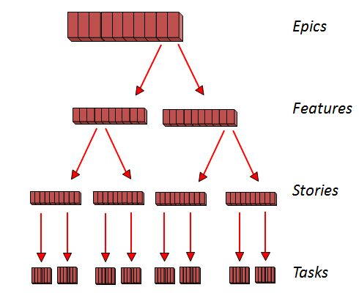
In Agile

Slide 4
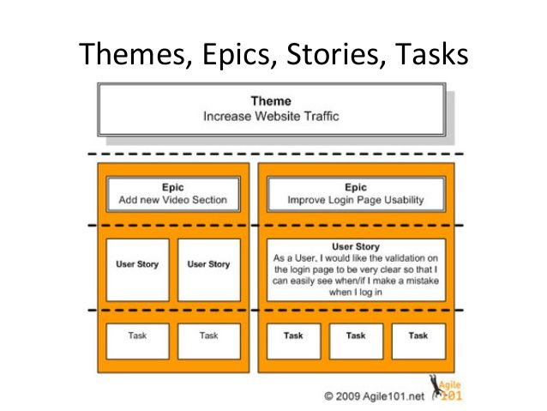
Example

Slide 5
Requirements Specification
(Week 4)

Slide 6
Software Requirements Specification (SRS)
Main aim of requirements specification:
  Systematically organize the requirements arrived during requirements analysis.
  Document requirements properly.

Slide 7
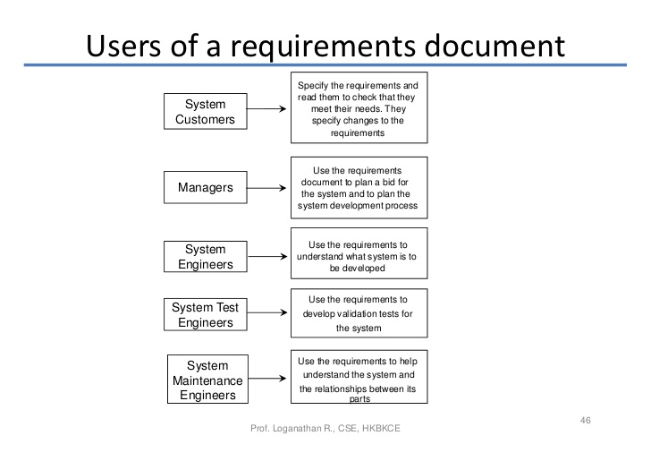

Slide 8
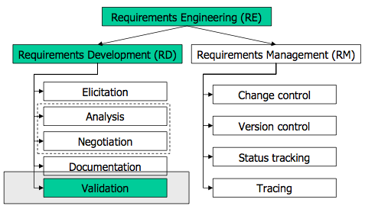
Requirements Processes

Slide 9
Software Requirements Specification
The SRS document is useful in various contexts:
  Statement of user needs
  Contract document
  Reference document
  Definition for implementation

Slide 10
Software Requirements Specification: A Contract Document
Requirements document is a reference document.
SRS document is a contract between the development team and the customer.
  Once the SRS document is approved by the customer,
    Any subsequent controversies are settled by referring the SRS document.

Slide 11
Software Requirements Specification: A Contract Document
Once customer agrees to the SRS document:
  Development team starts to develop the product according to the requirements recorded in the SRS document.
The final product will be acceptable to the customer:
  As long as it satisfies all the requirements recorded in the SRS document.

Slide 12
SRS Document (CONT.)
The SRS document is known as black-box specification:
  The system is considered as a black box whose internal details are not known.
  Only its visible external (i.e. input/output) behavior is documented.
S
Output Data
Input Data

Slide 13
SRS Document (CONT.)
SRS document concentrates on:
  What needs to be done
  Carefully avoids the solution (“how to do”) aspects.
The SRS document serves as a contract
  Between development team and the customer.
  Should be carefully written

Slide 14
SRS Document (CONT.)
The requirements at this stage:
  Written using end-user terminology.
If necessary:
  Later a formal requirement specification may be developed from it.

Slide 15
Properties of a Good SRS Document
It should be concise
  and at the same time should not be ambiguous.
It should specify what the system must do
  and not say how to do it.
Easy to change.,
  i.e. it should be well-structured.
It should be consistent
It should be complete

Slide 16
Properties of a Good SRS Document (cont...)
It should be traceable
  You should be able to trace which part of the specification corresponds to which part of the design, code, etc and vice versa.
It should be verifiable
  e.g. “system should be user friendly” is not verifiable

Slide 17
SRS Document (CONT.)
SRS document, normally contains three important parts:
  Functional requirements,
  Non-functional requirements,
  Goals of Implementation.

Slide 18
SRS Document (CONT.)
It is desirable to consider every system:
  Performing a set of functions {fi}.
  Each function fi considered as:
  Transforming a set of input data to corresponding output data.
Input Data
Output Data
fi

Slide 19
Example: Functional Requirement
F1: Search Book
  Input:
    an author’s name:
  Output:
    details of the author’s books and the locations of these books in the library.
Author Name
Book Details
f1

Slide 20
Functional Requirements
Functional requirements describe:
  A set of high-level requirements
  Each high-level requirement:
    takes in some data from the user
    outputs some data to the user
  Each high-level requirement:
    might consist of a set of identifiable functions

Slide 21
Functional Requirements
For each high-level requirement:
  Every function is described in terms of:
    Input data set
    Output data set
    Processing required to obtain the output data set from the input data set.

Slide 22
Nonfunctional Requirements
Characteristics of the system which can not be expressed as functions:
    Maintainability,
    Portability,
    Usability, etc.

Slide 23
Nonfunctional Requirements
Nonfunctional requirements include:
  Reliability issues,
  Performance issues:
    Example: How fast the system can produce results
      so that it does not overload another system to which it supplies data, etc.
  Human-computer interface issues,
  Interface with other external systems,
  Security, maintainability, etc.

Slide 24
Non-Functional Requirements
Hardware to be used,
Operating system
  or DBMS to be used
Capabilities of I/O devices
Standards compliance
Data representations
  by the interfaced system

Slide 25
Goals of Implementation
Goals describe things that are desirable of the system:
  But, would not be checked for compliance.
  For example,
    Reusability issues
    Functionalities to be developed in future

Slide 26
Organization of the SRS Document
Introduction.
Functional Requirements
Nonfunctional Requirements
  External interface requirements
  Performance requirements
Goals of implementation

Slide 27
Functional Requirements
A high-level function is one:
  Using which the user can get some useful piece of work done.
Can the receipt printing work during withdrawal of money from an ATM:
  Be called a useful piece of work?
A high-level requirement typically involves:
  Accepting some data from the user,
  Transforming it to the required response, and then
  Outputting the system response to the user.

Slide 28
High-Level Function
A high-level function:
  Usually involves a series of interactions between the system and one or more users.
Even for the same high-level function,
  There can be different interaction sequences (or scenarios)
  Due to users selecting different options or entering different data items.

Slide 29
Example Functional Requirements
List all functional requirements
  with proper numbering.
Req. 1:
  Once the user selects the “search” option,
    he is asked to enter the key words.
  The system should output details of all books
    whose title or author name matches any of the key words entered.
    Details include: Title, Author Name, Publisher name, Year of Publication, ISBN Number, Catalog Number, Location in the Library.

Slide 30
Example Functional Requirements
Req. 2:
  When the “renew” option is selected,
    The user is asked to enter his membership number and password.
  After password validation,
    The list of the books borrowed by him are displayed.
  The user can renew any of the books:
    By clicking in the corresponding renew box.

Slide 31
Req. 1:
R.1.1:
  Input: “search” option,
  Output: user prompted to enter the key words.
R1.2:
  Input: key words
  Output: Details of all books whose title or author name matches any of the key words.
    Details include: Title, Author Name, Publisher name, Year of Publication, ISBN Number, Catalog Number, Location in the Library.
  Processing: Search the book list for the keywords

Slide 32
Alternatively/Additionally…
Use cases can be used for representing functional requirements

Slide 33
Req. 2:
R2.1:
  Input: “renew” option selected,
  Output: user prompted to enter his membership number and password.
R2.2:
  Input: membership number and password
  Output:
    list of the books borrowed by user are displayed. User prompted to enter books to be renewed or
    user informed about bad password
  Processing: Password validation, search books issued to the user from borrower list and display.

Slide 34
Req. 2:
R2.3:
  Input: user choice for renewal of the books issued to him through mouse clicks in the corresponding renew box.
  Output: Confirmation of the books renewed
  Processing: Renew the books selected by the in the borrower list.

Slide 35
Examples of Bad SRS Documents
Unstructured Specifications:
  Narrative essay --- one of the worst types of specification document:
    Difficult to change,
    Difficult to be precise,
    Difficult to be unambiguous,
    Scope for contradictions, etc.

Slide 36
Examples of Bad SRS Documents
Noise:
  Presence of text containing information irrelevant to the problem.
Silence:
  aspects important to proper solution of the problem are omitted.

Slide 37
Examples of Bad SRS Documents
Overspecification:
  Addressing “how to” aspects
  For example, “Library member names should be stored in a sorted descending order”
  Overspecification restricts the solution space for the designer.
Contradictions:
  Contradictions might arise
    if the same thing described at several places in different ways.

Slide 38
Examples of Bad SRS Documents
Ambiguity:
  Literary expressions
  Unquantifiable aspects, e.g. “good user interface”
Forward References:
  References to aspects of problem
    defined only later on in the text.
Wishful Thinking:
  Descriptions of aspects
    for which realistic solutions will be hard to find.

Slide 39
User Stories – example structure
As a [Type of USER],
[Function to Perform (some goal)]
so that [Business Value (some reason)]
Example: As a user, I can indicate folders not to backup so that my backup isn’t filled up with things I don’t need saved

